Slide 1
Ghost Tunnel Data transmission based on WiFi covert channel
Chengqiang Jin,M.S.
College of Computer Science and Technology
Zhejiang University of Technology
king_jcq@163.com

Slide 2
Agenda
Introduction
Previous research on Ghost Tunnel
Ghost Tunnel implementation
Further application of Ghost Tunnel

Slide 3
Introduction
Air-Gapping
Attack payload

Slide 4
Air gapping
Air gapping
- Wikipedia: “air gapping is a network security measure employed on one or more computers to ensure that a secure computer network is physically isolated from unsecured networks, such as the public Internet or an unsecured local area network. The name arises from the technique of creating a network that is physically separated (with a conceptual air gap)
from all other networks.”
Air gapping aims to avoid the intrusion and data leakage through network connections

Slide 5
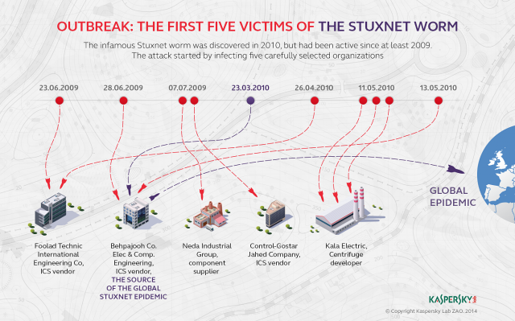
Stuxnet Worm (2010)
Attacking initiated via an infected USB drive
Designed to attack the Yilan nuclear facility

Slide 6
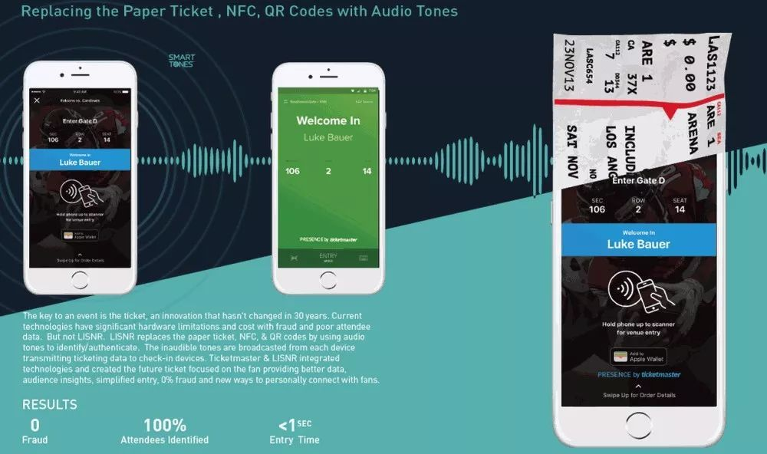
Attack payload – 1
Transmission of data using infrasonic waves or ultrasonic

Slide 7
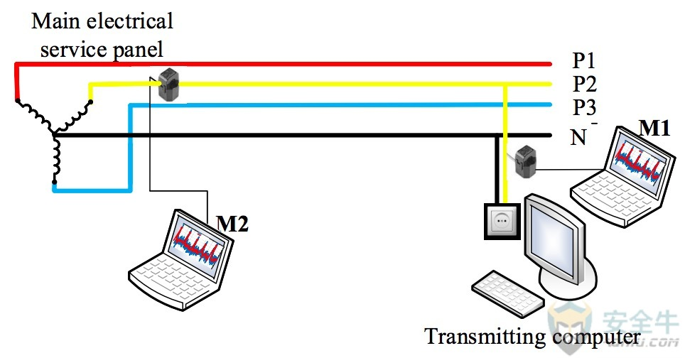
Attack payload – 2
Stealing computer data from a power line

Slide 8
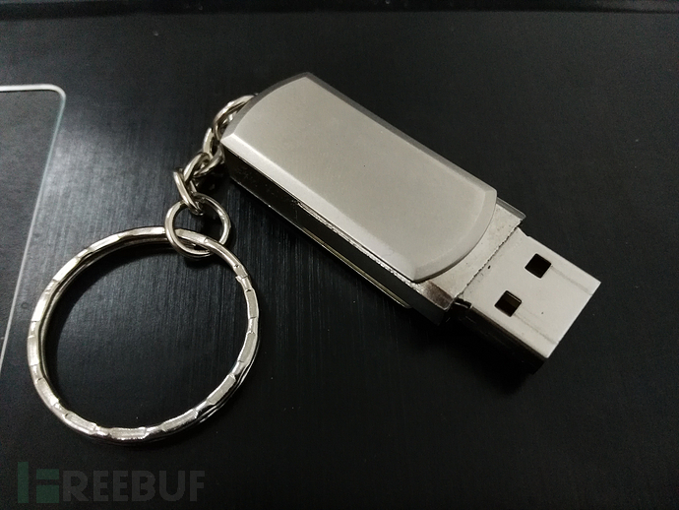
Attack payload – 3
HID attack
BadUSB
Bushbussy
Yellow Ducky

Slide 9
Previous research on Ghost Tunnel

Slide 10
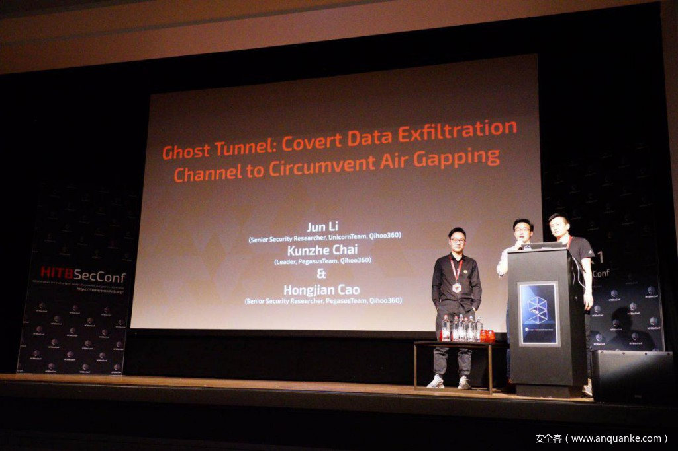
Pegasus Team
360 Security Technology

Slide 11

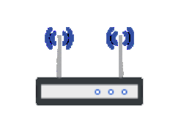
Comman WiFi Connection
STA
AP
(1) Beacon(Broadcast SSID)
(2) Probe Request
Ghost Tunnel
(3) Probe Response
(4) Authentication Request
(5) Authentication Response
(6) Association Request
(7) Association Response
WiFi Connection Established

Slide 12


Ghost Tunnel – No WiFi Connection
A covert WiFi channel using Beacon, Probe Request, Probe Response
A special SSID as the identifier
SSID : gt
Probe Request
Fake AP
Beacon/Probe Response

Slide 13
Ghost Tunnel Implementation

Slide 14
Through Operating System WiFi API
• Windows
- Native Wifi API
• Mac OSX
- coreWLAN
• Linux
- nl80211 & libnl

Slide 15
Winodws Platform
DWORD WINAPI WlanScan(
_In_ HANDLE hClientHandle,
_In_ const GUID *pInterfaceGuid,
_In_opt_ const PDOT11_SSID pDot11Ssid,
_In_opt_ const PWLAN_RAW_DATA pIeData,
_Reserved_ PVOID pReserved );
DOT11_SSID pDot11Ssid
uSSIDLength | ucSSID(payload)
WLAN_RAW_DATA pIeData
dwDataSize | ElementID | Length | Information(payload)

Slide 16
Hostapd
Hostapd.conf
Vendor element
ElementID(dd) | Payload Length | Payload
Fragment ID | Magic code | Shell
Next SSID | Magic code | Shell

Slide 17
Demo

Slide 18
Further application of Ghost Tunnel

Slide 19
Transfer Files
Hello World.doc
01010000101010111101111……
0x1e0x09……
Divide in Fragment
Use Ghost Tunnel
Piece 1
Piece 2
Hello World.doc
Piece 3
Piece ….

Slide 20
Fragmentation
ElementID(dd) | Payload Length | Payload
ElementID(dd) | Payload Length | Total Fragment | Fragment ID | Payload
Theoretical transmission rate: 1K/s ~ 2K/s

Slide 21
Thanks!
Any questions?

